Slide 1

Credit Card Fraud Detection using Parallel and Distributed Computing techniques
CSYE 7105 High Performance Parallel Machine Learning and AI
Team 05 Nikita Gaurihar - 002980962
Ronak Patil - 001007035

Slide 2

Agenda
Introduction
Objective
Data Description
Methodology
Exploratory Data Analysis
Machine Learning Models
Parallel Computing using Dask
Evaluation Metrics
Conclusion
References

Slide 3
Introduction
In today’s era, where digitalized banking is promoted, Banks need to keep track of legitimate cashflows for each account.
The most fascinating use of Machine learning along with Parallel computing in Finance Industry was when an algorithm was developed to predict the future stock price.
Dealing with such a million amounts of real-time data needs high computational powers which our local machines with single core unit cannot handle resulting in the system meltdown due to heat generated due to processing.
This is where the use of Parallel and Distributed computing techniques comes into picture.
This project focusses on identifying fraudulent transactions of Credit cards used by customers.

Slide 4

Objective
To predict the Credit Card Frauds using Parallel and Distributed Computing techniques
Comparison of Model Performances of Sequential Execution and Parallel Execution
Analysis on Model Performance based on Evaluation Metrics

Slide 5
Dataset Description
To implement this into practice, we are using the following Kaggle Dataset –
https://www.kaggle.com/datasets/kartik2112/fraud-detection?select=fraudTrain.csv
index
transaction_time
cc_num
merchant
category amt
first
Last
gender
street
city
state
zip
lat
long
city_pop
job
dob
trans_num
unix_time
is_fraud

Slide 6

Methodology
Exploratory Data Analysis

Slide 7
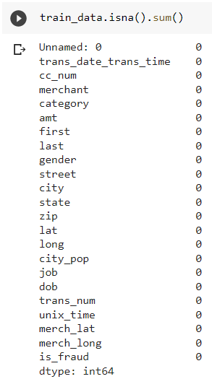
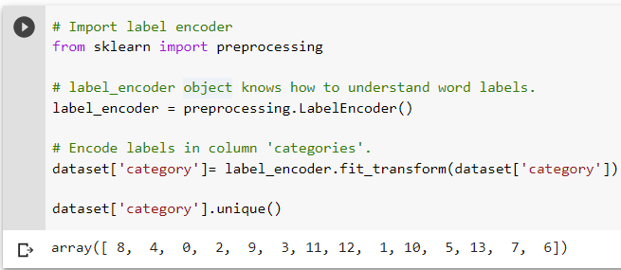

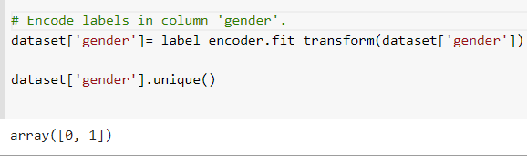
Methodology - Exploratory Data Analysis
Dataframe Dimensions:
Records = 1852394
Attributes = 23
Null Check ?
Feature Engineering using ‘Date of Birth’ and ‘Transaction_Time’:
Age
Hour
Day
Month
Year
Label Encoder
No Nulls
Normalisation

Slide 8
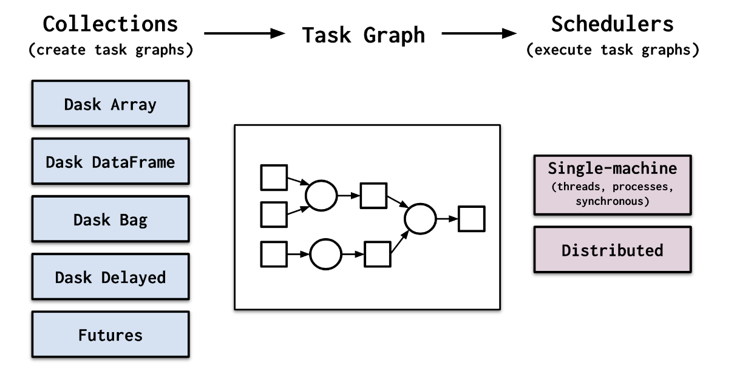
Methodology – Parallel Computing Using Dask
Machine Learning Models through Parallel Computing using Dask
Trained 3 Models through parallel processing with CPUs = 1,2,4,8

Slide 9
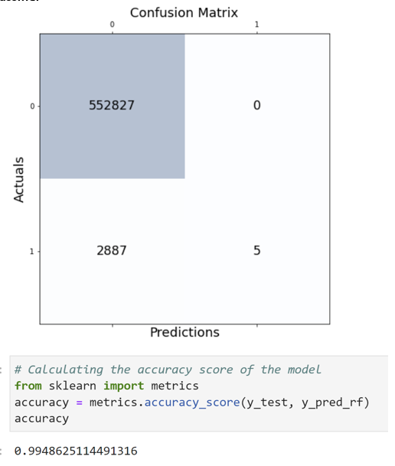
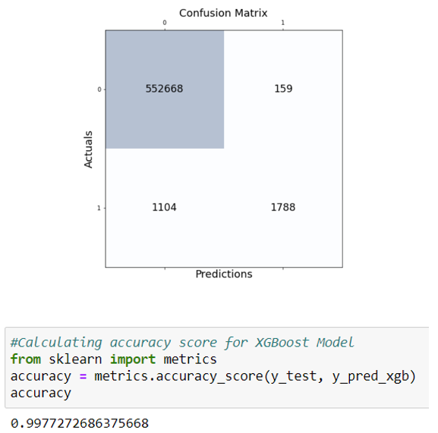
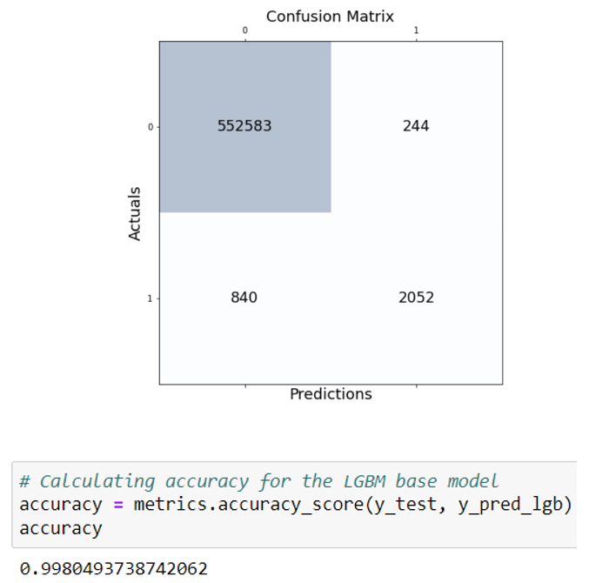
Evaluation Metrics – ML Models
Random Forest Classifier
XGBoost Classifier
Light Gradient Boost Classifier

Slide 10
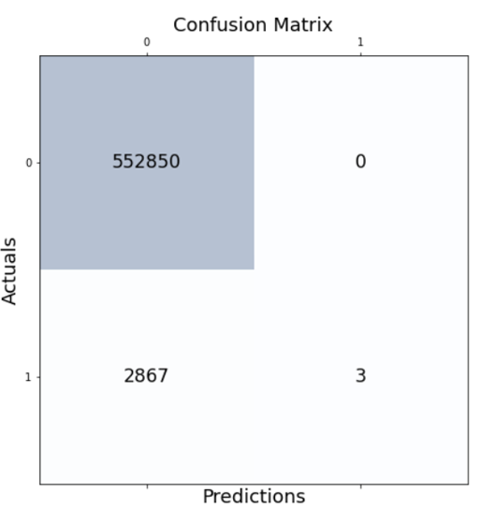
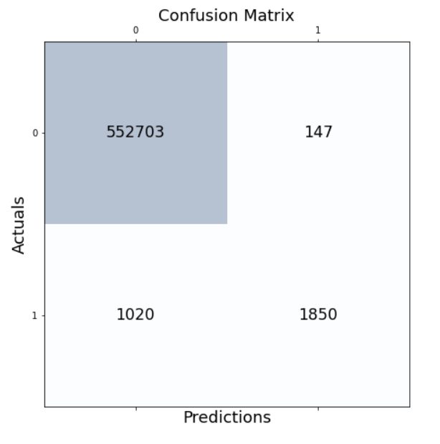
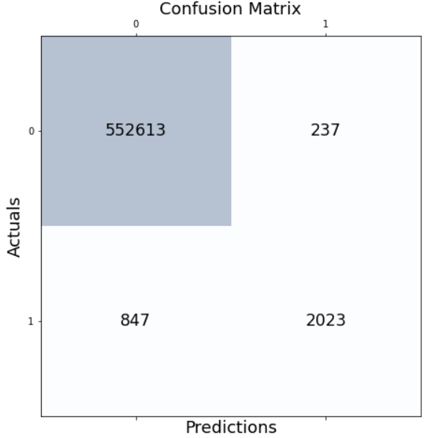

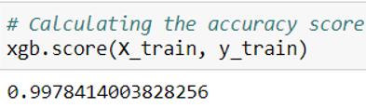

Evaluation Metrics – Parallel Computing Using Dask
Random Forest Classifier
XGBoost Classifier
Light Gradient Boost Classifier

Slide 11
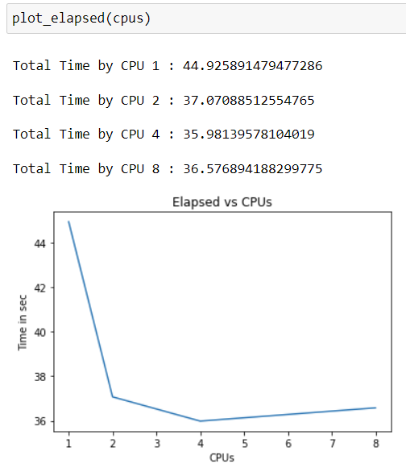
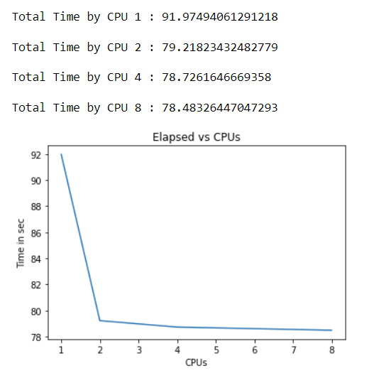
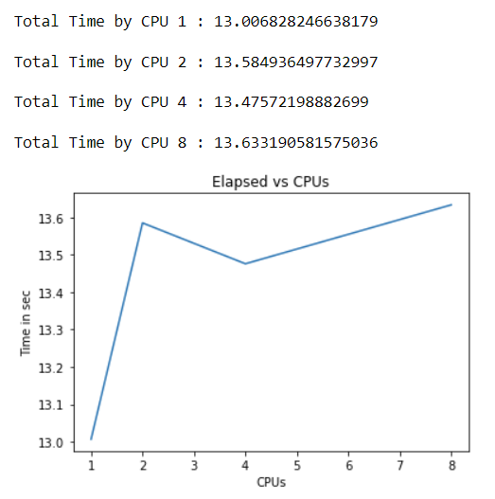
Evaluation Metrics – # CPU v/s Time
Random Forest Classifier
XGBoost Classifier
Light Gradient Boost Classifier

Slide 12
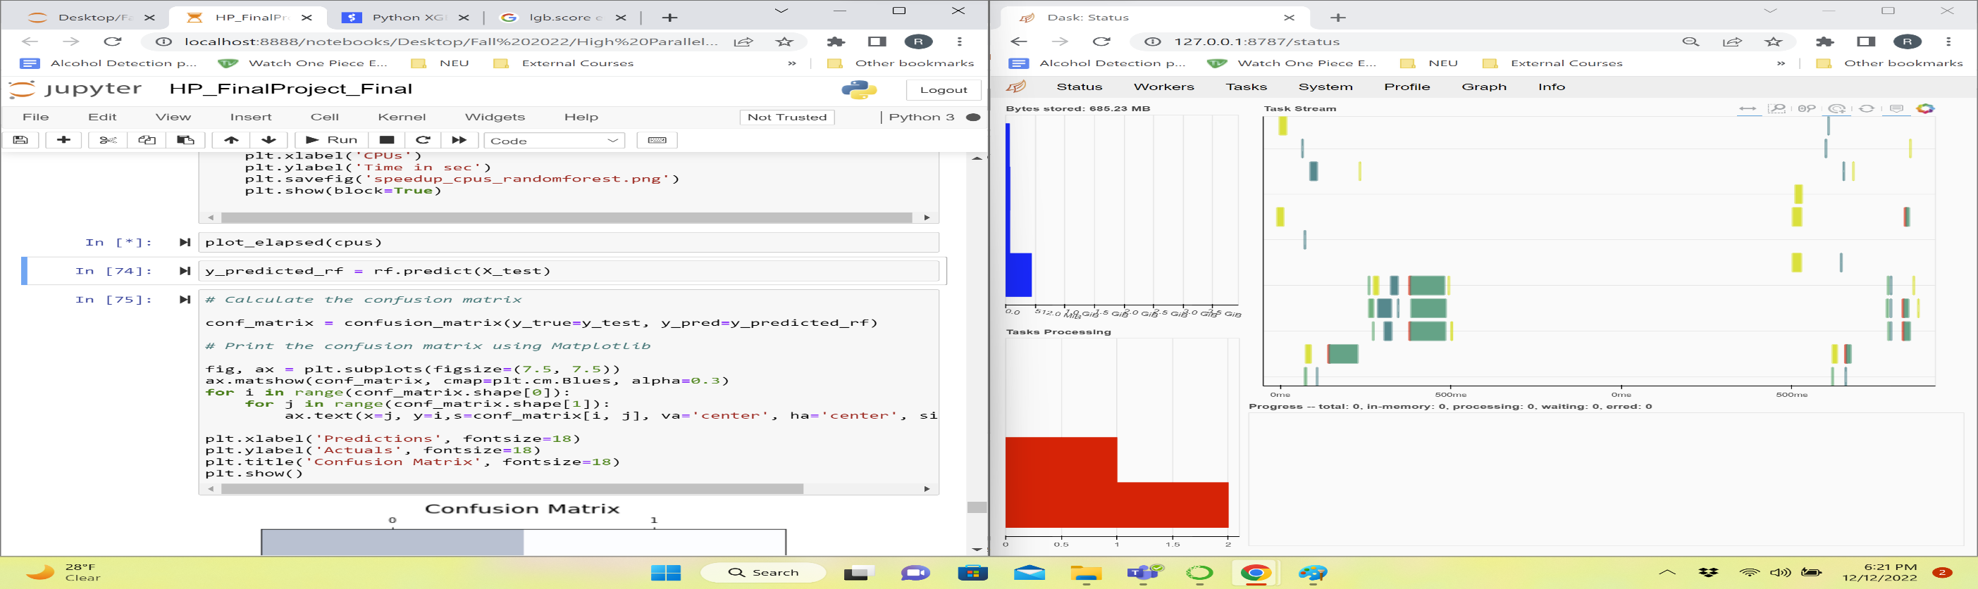
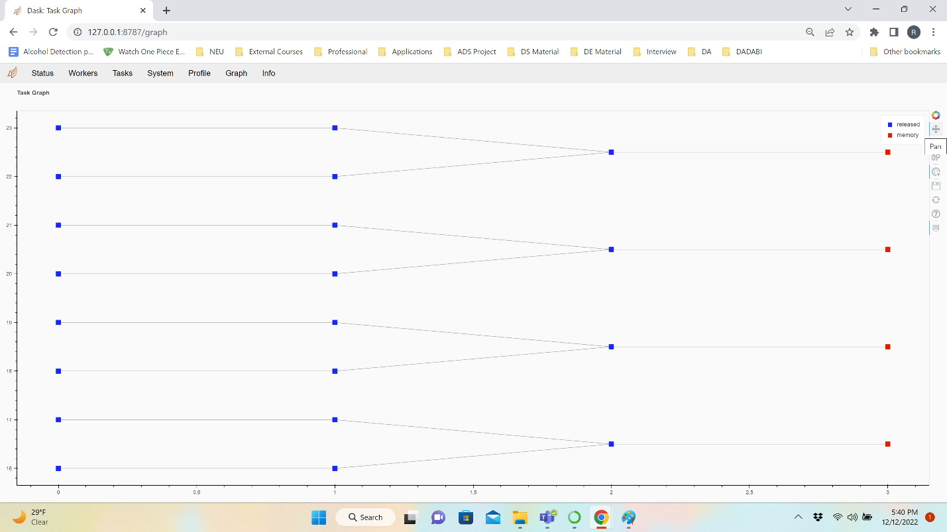
Dask Dashboard: Random Forest Classifier

Slide 13
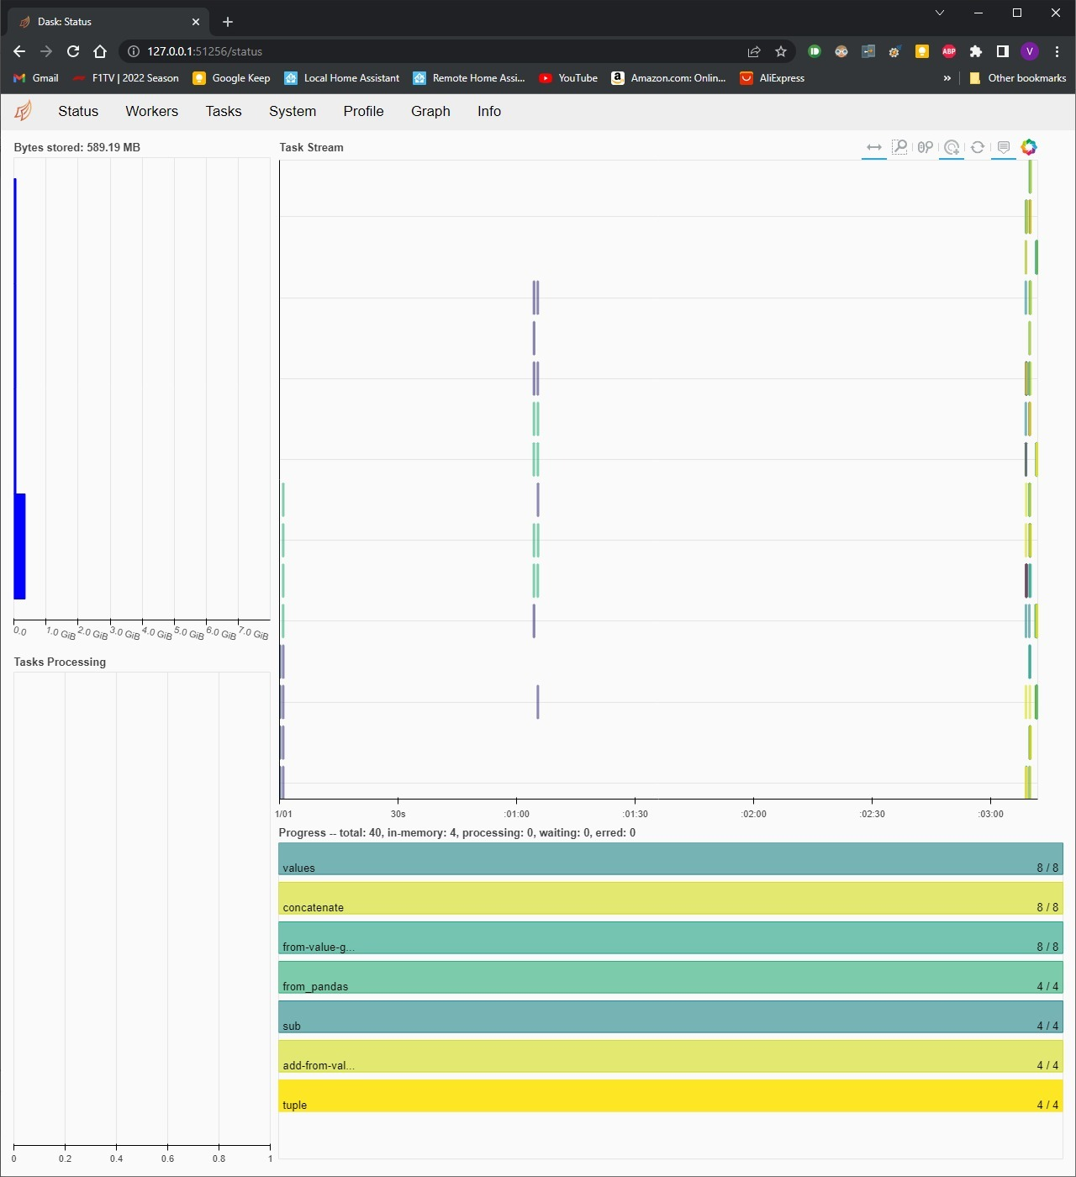
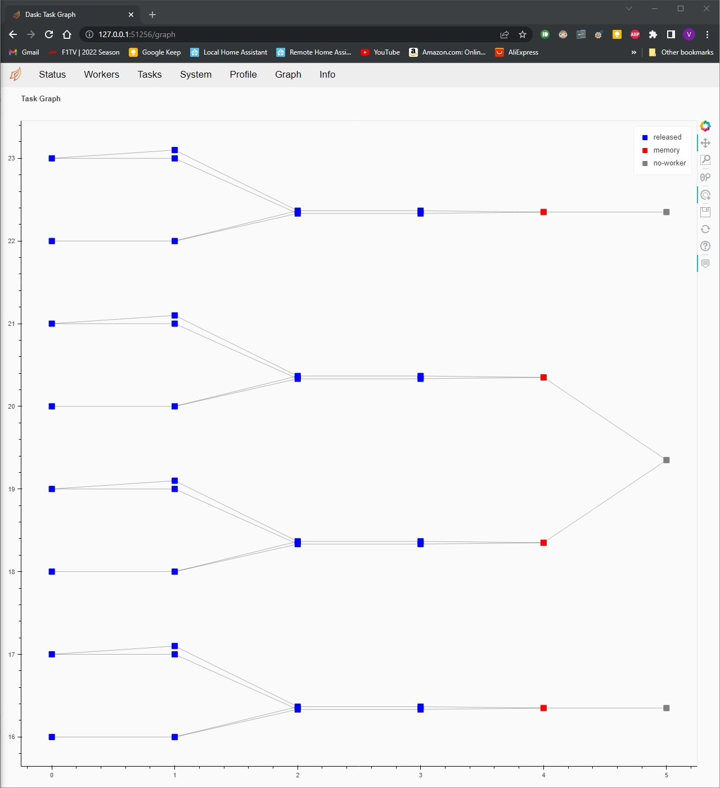
Dask Dashboard: Xgboost Classifier

Slide 14
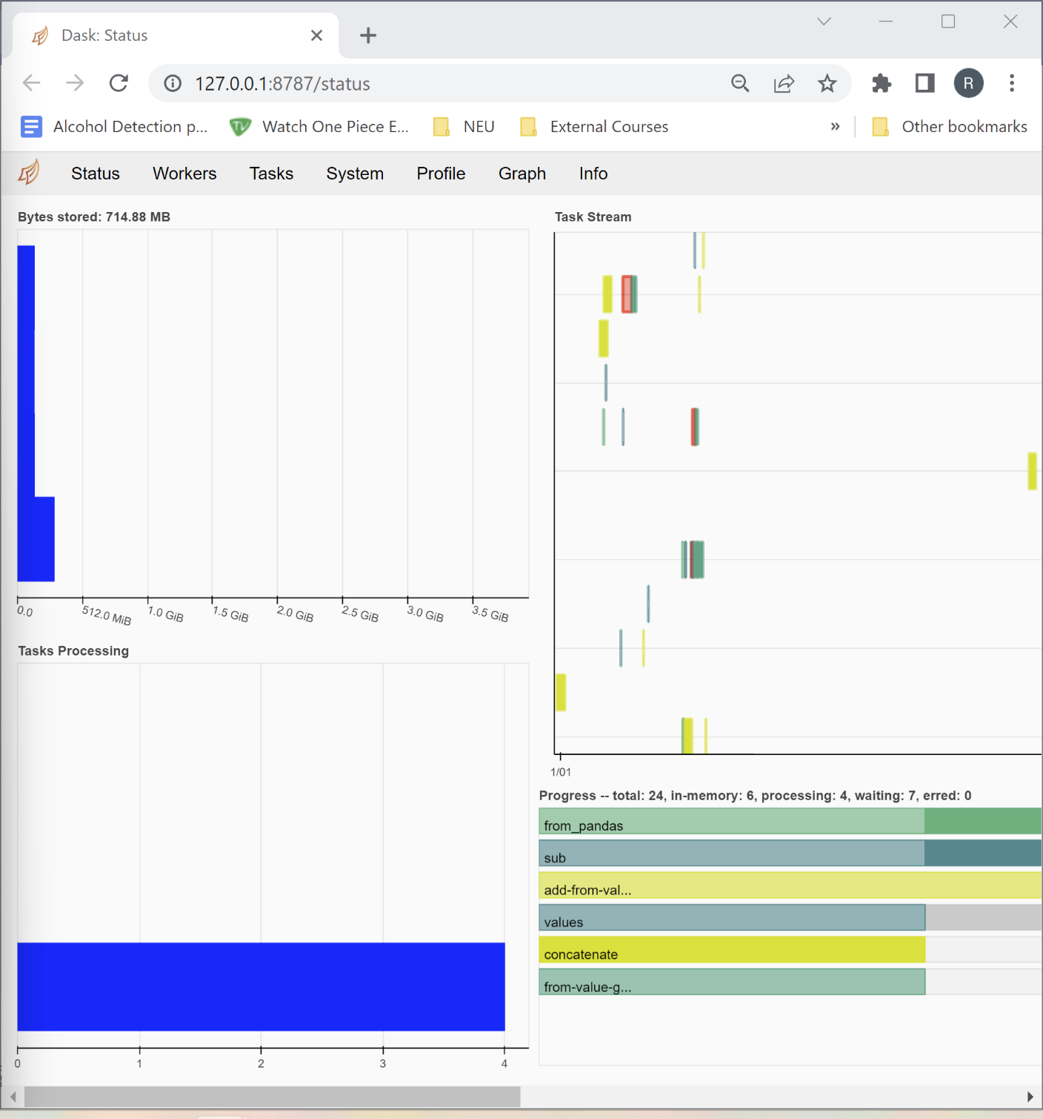
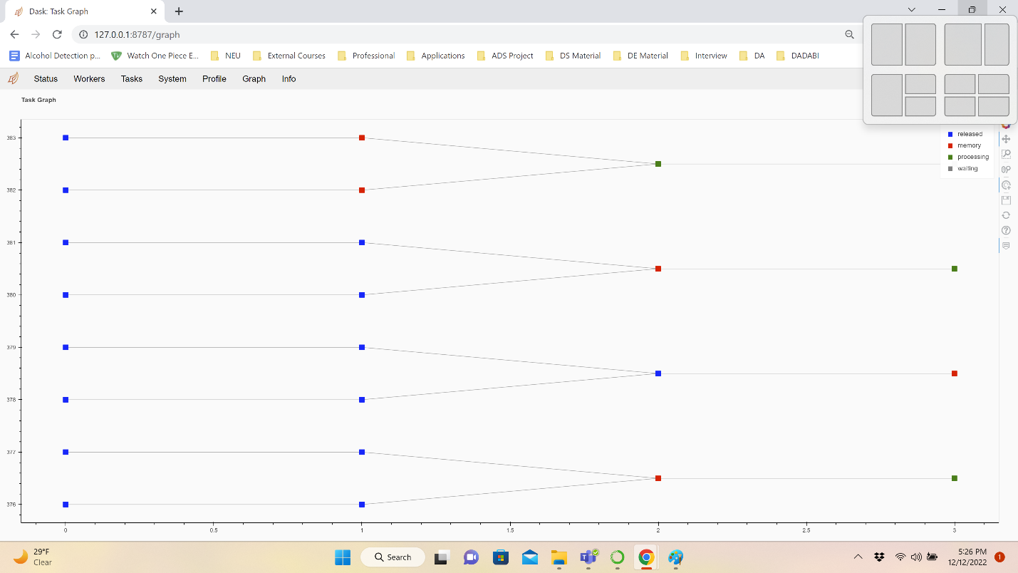
Dask Dashboard: Light GBM Classifier

Slide 15
Conclusion
From the model evaluation metrics, we can conclude that the XGBoost model is the best performing model as its accuracy improved by 0.01% as we trained the model on multiple CPUs. The optimum number of CPUs required to process is 4.
However, Random Forest Classifier showed better performance with efficiency of 2.05 on CPU =1 even when processed parallelly
Light Gradient Descent Boost Model ran fastest among the other two. However, the efficiency and speedup are less as compared to the other two models
Utilizing additional CPUs intermittently does not increase performance. There are instances where we receive unexpected outcomes for a parallel computation using Dask.

Slide 16
References
[1] Dask — Dask documentation. (n.d.). https://docs.dask.org/en/stable/
[2] Somasundaram, A. (2018, July 17). Parallel and incremental credit card fraud detection model to handle concept drift and data imbalance. SpringerLink. https://link.springer.com/article/10.1007/s00521-018-3633-8?error=cookies_not_supported&code=024a9709-9587-4678-8356-84e957f12113
[3] Singh, A. (2022, July 21). Ultimate guide to handle Big Datasets for Machine Learning using Dask (in Python). Analytics Vidhya. https://www.analyticsvidhya.com/blog/2018/08/dask-big-datasets-machine_learning-python/
[4] Optimizing Fraud Detection in Financial Services with Graph Neural Networks and NVIDIA GPUs. (2022b, October 20). NVIDIA Technical Blog. https://developer.nvidia.com/blog/optimizing-fraud-detection-in-financial-services-with-graph-neural-networks-and-nvidia-gpus/
[5] Sahni, Sartaj & Thanvantri, Venkat. (2002). Parallel Computing: Performance Metrics and Models.
[6] Mwiti, D. (2022, August 11). Machine Learning in Dask - Heartbeat. Medium

Slide 17

Thank You

